Slide 1
New Models of Care in England
Professor Mike Roberts
Barts Health NHS Trust
UCLPartners
Royal College of Physicians of London

Slide 2

A brief overview of how the NHS works

Slide 3
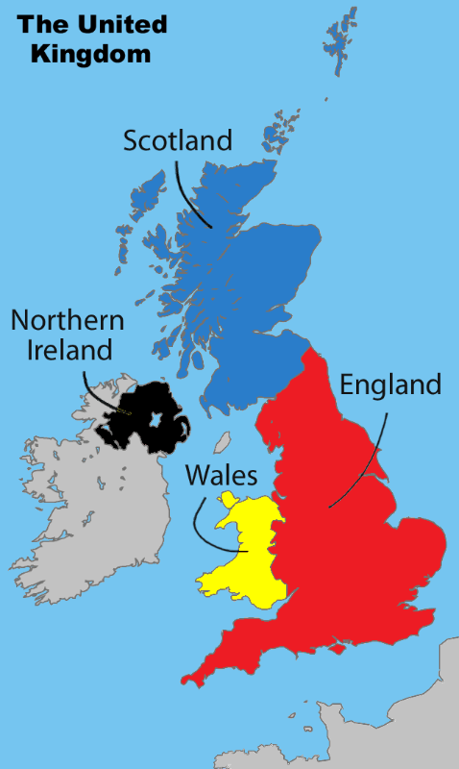
A brief overview of the UK National Health Service
The UK NHS as 4 Devolved Systems

Slide 4
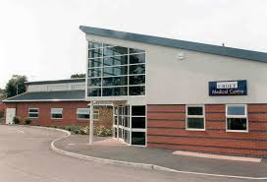
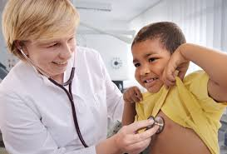
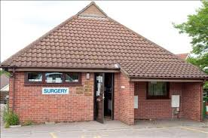
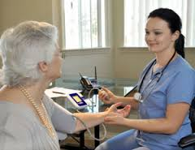
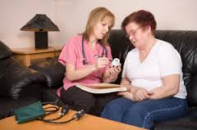

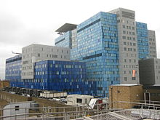
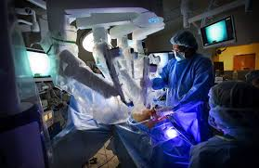

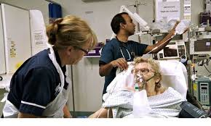

The patient perspective

Slide 5
NHS England facts and figures
Planned expenditure is £118,829,000,000 2016/17
Equates to £2057 p.a. per head of the population
NHS employs 149,808 doctors (43,000 GPs),
328,122 nurses (23,066 practice nurses)
2.8 doctors per 1000 population, 4.1 Germany, 3.9 Italy, 3.5 Spain, 3.0 N Zealand, 2.6 Canada, China 1.3
2.7 beds per 1000 population, 8.2 Germany, 3.0 Spain, 2.8 N Zealand, China 2.5
Only 7.23% of NHS funding goes to Primary Care

Slide 6
How is the money distributed?

Slide 7
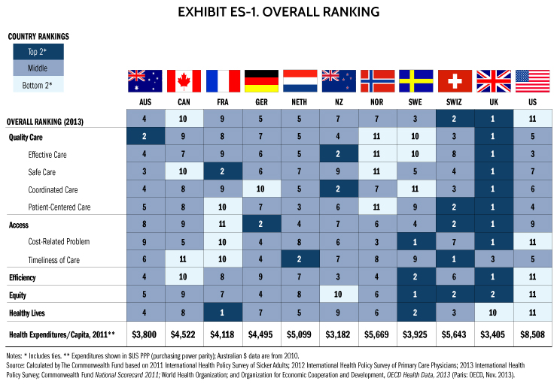
How well does this system work?

Slide 8

There is an estimated £22billion funding gap for the UK NHS

Slide 9
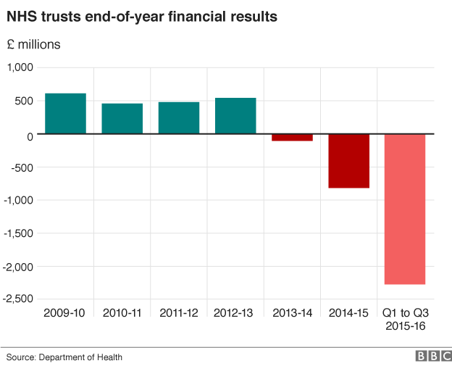
What do analysts think caused the current financial pressures?
The challenge of balancing quality and safety and cost – such as safe staffing levels, leading to increased staffing bill and agency spend – some figures show provider costs went up more than income.
Long-term conditions are now 70% of the NHS spend, these are growing and not going away, we are not actively preventing them well enough.
Supporting the ageing population – social care has faced significant cuts over a number of years, often less provision for vulnerable and older people – a growing group.
Unwarranted variation in clinical care and waste in many non-clinical areas that is continuing and until this is hindering our abilities to achieve cost improvements.
NHS funding, although ring-fenced, has reduced and has not always resulted in additional £ for frontline

Slide 10

The NHS Strategy 2015-2020 – getting everyone aligned
Recognises that the NHS has performed very well despite the biggest financial challenge in its history
Articulates the need for change, addressing three gaps:
The health and wellbeing gap
The care and quality gap
The funding and efficiency gap
Describes the vision for the future and the journey to get there including making the case for additional government funding

Slide 11
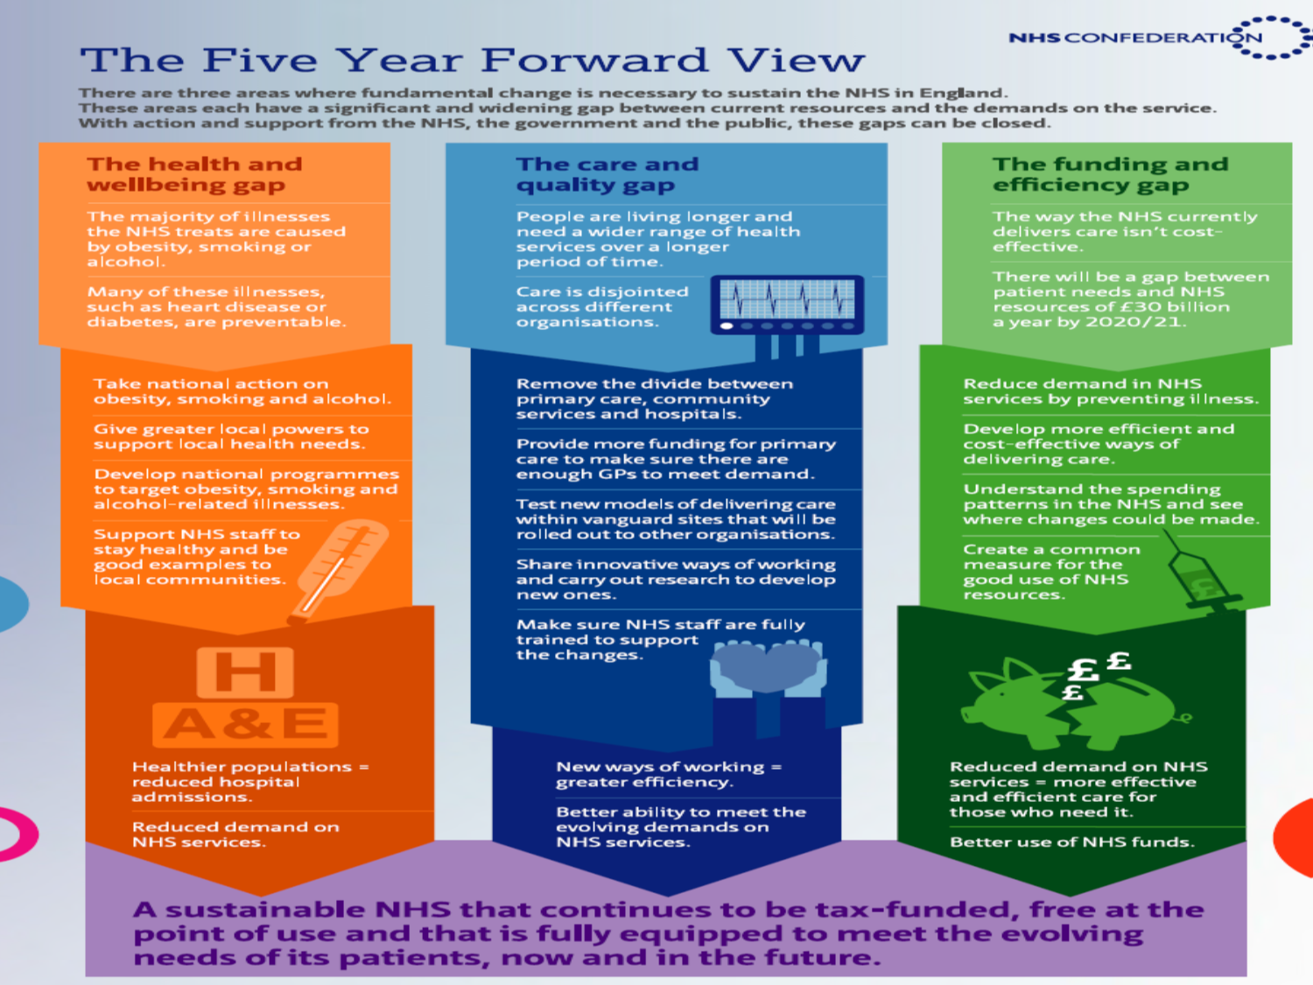

Slide 12


New care models
The New Care Models
Our values: clinical engagement, patient involvement, local ownership, national support
^{www.england.nhs.uk/vanguards}
^{#futureNHS}

Slide 13
Structured tests of new ways of working across traditional boundaries
Improve prevention and public health
Give people greater control over their care
Break down barriers in how care is provided
Build a sustainable NHS
Test the models and develop blueprints for widespread adoption
The aim of new care models
Greater focus on care out-of-hospital care and prevention
NHS trusts, GPs, Local Authorities, the voluntary sector and other providers will all work together for the benefit of their population
A long term focus
A focus on supporting vanguard sites to embody nationally replicable models of care
How this is different
How will it address the 3 “gaps”
The programme will bring investment, both locally and in national support
Dedicated national expertise to work with local systems to unblock barriers
The programme will aim to play “matchmaker” in bringing together parts of the system
13

Slide 14
Initiatives
Prime Minister’s Challenge Fund
Integrated Care Pioneers
Vanguards
Devolution pilots - ACOs etc
Sustainability & Transformation Plans
Place based care

Slide 15
Prime Minister’s Challenge Fund
Extended access to General Practice
Longer Opening Hours
Co-operatives of groups of practices
Use of telemedicine consultations
Electronic appointment booking
Conclusion: some enthusiasm from the public, reduction in minor ailment attendance at hospital, no impact on serious illness and injury attendance or admission to hospital

Slide 16
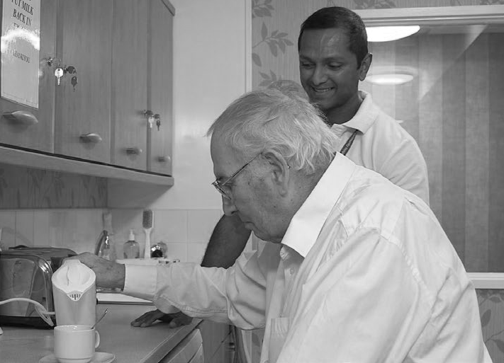

Integrated care pioneers
The 25 integrated care pioneers are developing and testing new and different ways of joining up health and social care services across England. Communities and local services are working together at all stages of the planning cycle, from identifying needs and procurement of services through to implementation and evaluation
Islington’s Integrated Digital Care Record (IDCR) is a key part of their integration programme, which allows the sharing of data across the full range of care services. The system provides a holistic view of patient and service user data from multiple care providers. Records access is a major barrier for professionals and the IDCR will be a key enabler for more joined-up care and a better experience for patients
Cornwall’s living well programme is aiming to move people away from unscheduled health management to more structured, planned use of services over the long term. The approach identifies people’s priorities through a guided conversation with a voluntary worker, which leads to small confidence building steps and social activity that ultimately have a positive effect on the person’s health, independence and wellbeing
Vale of York’s integration pilots are helping individuals stay out of acute care settings – either remaining at home or returning there as soon as possible. The three pilots each have local care hubs which consist of integrated teams made up of doctors, nurses, social workers, occupational and physiotherapists, generic and specialist reablement support workers, among others. Each team meets face to face on a regular basis to share, discuss and plan care for patients and service users – each of whom has a single, named point of contact for all their care needs
Our values: clinical engagement, patient involvement, local ownership, national support
^{www.england.nhs.uk/vanguards}
16
^{#futureNHS}

Slide 17
New Models of Care: Vanguard Sites
Multispecialty
Community Providers
- moving specialist care out of hospitals into the community
Integrated primary and acute care systems
- joining up GP, hospital, community and mental health services
Acute care
collaboration
- local hospitals working together to enhance clinical and financial viability
Enhanced health in care homes
- offering older people better, joined up health, care and rehabilitation services
Urgent and emergency
care
- new approaches to improve the coordination of services & reduce pressure on A&E departments.

Slide 18

Acute care collaboration (ACC) vanguards
This group of 13 vanguards is developing new ways to improve the quality and efficiency of hospital services. They include some of the best-known hospitals in England who are extending their geographical reach, stepping up to the challenge of driving efficiency and improvement across the country. The aim is to spread excellence in hospital services and management across multiple geographies
Vanguards making it happen
The Neuro Network will see the Walton Centre collaborating with local commissioners and providers to maintain local access to neuro and spinal services in both community and smaller District General Hospital settings
Moorfields already provides ophthalmology services across 22 sites in and around London. The vanguard will extend this work, and make it readily available for other providers to replicate, by developing standardised clinical, financial and operating models for ophthalmology services
The National Orthopaedic Alliance will be leading on the development of quality-based membership clubs that will allow providers to kite mark their services for specific specialties as best practice, with support from national bodies to ensure that this is underpinned by a strong supporting evidence base
18

Slide 19

Urgent and emergency care (UEC) vanguards
Eight vanguards are redesigning the experience for patients needing urgent or emergency treatment. The aim is to help people get the right advice in the right place, first time
Vanguards making it happen
Greater Nottingham System Resilience Group has a new navigation programme supported by a web-based application. This helps refer patients to the most suitable health and care service location, offering an alternative to an urgent hospital admission. The preliminary programme has delivered some promising results; reducing acute and emergency admissions
Solihull Together for Better Lives is about improving urgent and emergency care for the whole population, with an initial focus on transforming the way they provide care for older people. They are supporting patients/carers in their homes and the ‘Health and Wellbeing Campus’ (on the hospital site) through open and accessible information and services using various portals, building on the local “Solihull Connect” service
Leicester, Leicestershire and Rutland System Resilience Group will create a new alliance-based urgent and emergency care system where all providers work as one network. This will bring together ambulance, NHS 111, out-of-hours and single point of access services to ensure that patients get the right care, first time
19

Slide 20
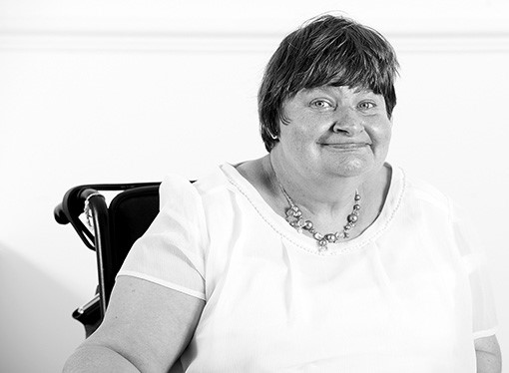
Enhanced health in care homes vanguards
Six vanguards are working to improve the quality of life, healthcare and planning for people with long term conditions living in care homes
Vanguards making it happen
Gateshead Care Home Project sees individual GP practices each allocated to a specific care home, making it possible to offer greater continuity of care and more effective prevention of illness through regular home visits
Airedale and partners is using technology to improve care locally: supporting residents who are sick by providing a secure video link to senior nurses, so they can remain in the care home. Have already seen a large reduction in hospital as place of death for palliative patients and reductions in A&E admissions/non-elective hospital admissions
Connecting Care in Wakefield has introduced E-learning for care home staff and carers to support well-being and resilience of people with dementia. This programme has had positive outcomes with improved engagement, reduced behaviours and more meaningful care planning
20

Slide 21
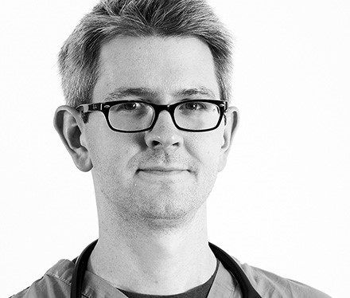
Multispecialty community providers (MCPs) vanguards
These 14 vanguards are focussing on taking services traditionally provided in hospitals into the community, bringing care nearer to patients’ homes
Vanguards making it happen
Better Local Care (Southern Hampshire) is piloting a new hub based same-day access service scheme is which is helping to make it easier for people to receive same-day consultations with a GP, nurse or relevant healthcare professional on the day they make contact. The pilot has freed up GP sessions back in practices, enabled longer appointments slots for patients with complex needs and reduced waiting time for routine appointments in practice from 3-4 weeks to 10-14 days
Fylde Coast Local Health Economy has launched two new services in the community, providing high-needs patients with proactive and coordinated care with a single point of access. These services help build patients’ confidence and give them the knowledge to manage their own
conditions better; five more similar services are planned to start in the next
18 months
Stockport is developing a facility to allow GPs to call consultants directly for advice initially across up to eight specialties. The vanguard will also utilise the skills of social care and voluntary sector partners to build community capacity in each neighbourhood
21

Slide 22
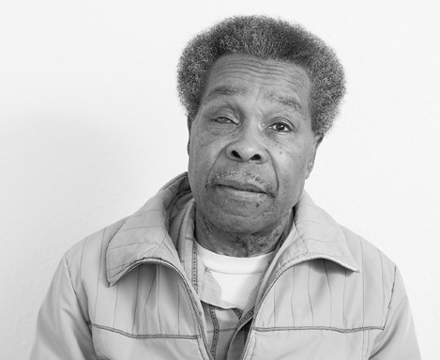
Integrated primary and acute care systems (PACS) vanguards
Nine areas are changing the ways health care has traditionally been provided, bringing much closer together family doctor, hospital, community, mental health and social care services in one single organisation or partnership. By coming together, one organisation will be responsible for people’s care whatever they need, whatever service
Vanguards making it happen
Mid-Nottinghamshire Better Together has teams of healthcare staff, social workers and volunteers now working together to provide prevention services to patients deemed to be at high risk of future admission. Also established a citizens’ board, made up of patient representatives, who support the development of communications and engagement activity
Better Care Together is developing multidisciplinary teams based within communities across Morecambe Bay. There will be increased general practice capacity and capability, with an expansion of community based specialist services
Isle of Wight’s integrated ‘My Life a Full Life’ model is prevention based, promotes health and wellbeing and is built on experience-based co-design. It is also founded on the principles of self-care and empowered communities
22

Slide 23
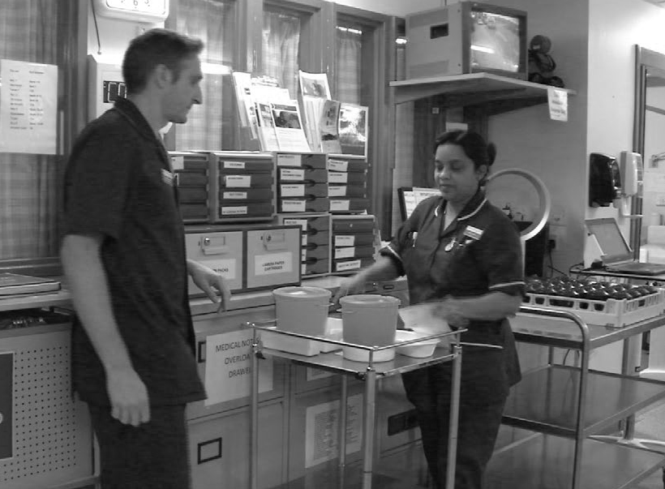
Common challenges across all sites
Leadership and development
Workforce
Commissioning and contracting
Evaluation
Information management and technology
Our values: clinical engagement, patient involvement, local ownership, national support
^{www.england.nhs.uk/vanguards}
23
^{#futureNHS}

Slide 24
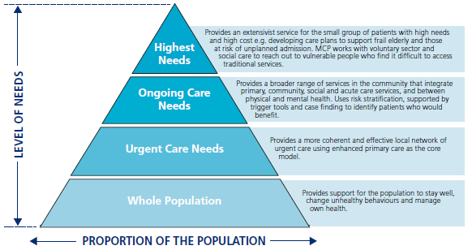
Multispecialty Community Providers - key elements

Slide 25
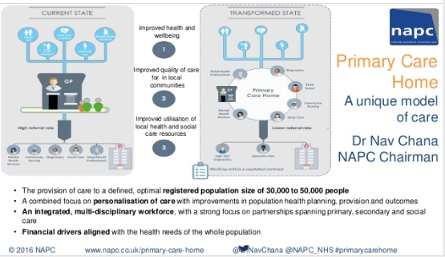

Slide 26
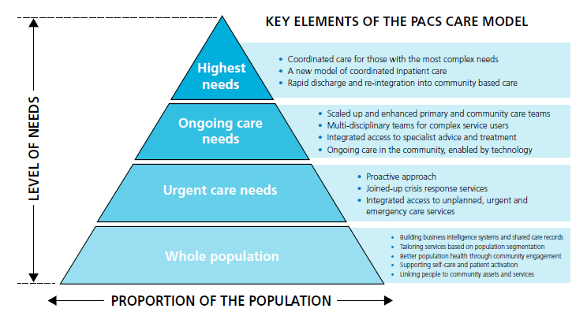
Integrated Primary & Acute Care Systems – key elements

Slide 27
Acute Care Collaborations - key elements emerging
There are two types of an ACC model emerging:
Foundation Groups
Clinical networks
Supported by two fundamental emerging characteristics:
Standardisation and evidence-based best practice
Consolidated decision-making mechanism
Trying to find solutions to the same challenges :
Financial pressures
Variation in clinical quality
Workforce recruitment and retention
Viability of specialised services
Notes:
Bringing together the providers of acute services (including acute mental health services) to provide care in a different way
Acute care collaborations (ACCs) are broadly focused on two challenges:
First, they are seeking to reduce avoidable variations in the cost and quality of acute care, as highlighted in publications such as the ‘NHS Atlas of Variation’ and ‘Getting it Right First Time’. This includes tackling variations by provider, by type of service and by the day or time at which patients require care.
Second, they are seeking to address challenges to the sustainability of acute hospital services. This includes responding to financial and workforce pressures, in addition to meeting new service standards, for example in relation to seven day working, while maintaining local services for patients.
They have two fundamental characteristics:
A strong, consolidated decision-making mechanism that is supra-organisational and ‘locks-in’ decisions and partners.
Rigorous use of the consolidated decision-making mechanism to identify and address the systematic issues, through the introduction of standardisation and evidence-based best practice.
Whilst all ACCs share these common building blocks, they can be deployed in different ways. As a result, there are two broad types of ACC:
Foundation Groups will develop and implement a ‘group model’ for NHS hospitals. This is not a simple extension of traditional hospital mergers that result in large multi-site trusts, rather this will be a flexible membership model that allows a number of hospitals to operate as part of a single group with a central headquarters.
Clinical networks will deliver rapid and sustained improvements in the systematic delivery of care by optimising patient pathways for services covered by the network, and by identifying and implementing best practice at each stage along those pathways.
In the past where these collaborations have been formalised, merger or acquisition has been the prevailing option. But this is changing as the foundation groups are exploring a range of options including: shared directors and support services; prime contract and contractual joint ventures; committees in common and corporate joint ventures.

Slide 28
Common components of successful new care models are emerging
While all vanguards are working in response to their different local needs, we are learning that there are common components across each of the first wave of care model types.
There are five core characteristics in the PACS framework emerging from the vanguard community
A population health and wellbeing care model
Accountability for the whole population
Integrated governance and organisational form to support population health
System leadership to support population health
Contracting and payment systems that support population health
There are four core components to the emerging MCP framework:
A population health and care model focused on proactive and preventative care tailored around the needs of the individual
Empowering patients and local people to support each other and themselves in their health and care
Multi disciplinary health care professionals working within an organisation that has accountability for the delivery of health and care services for their population;
Contracting and payment systems that incentivise and enable the delivery of services for population health
There are eight core themes to the framework emerging from the enhanced health in care homes vanguard community:
Holistic care and wellbeing
Enhanced primary care support
Multi-disciplinary team (MDT) in-reach models including coordinated social care
Access to urgent and emergency care when needed
Reablement
Supporting older people with complex co-morbidities including dementia and frailty
End of life care (EOL) plans
Person-centred, integrated care
Our values: clinical engagement, patient involvement, local ownership, national support
^{www.england.nhs.uk/vanguards}
^{#futureNHS}
28

Slide 29
Feb/March 2016 new initiative of the Sustainability and Transformation Plan for each regional geography. There are 44 identified nationally.

Slide 30
Sustainability & Transformation Plans for 2017/8 to 2020/21
STPs will cover all areas of England’s NHS & integrating local authority services (e.g. public health, social care).
Plans will need to address a series of national challenges, the Triple Aim of the Five Year Forward View.
“Transformation footprints” locally defined, based on natural communities
Because the footprint geographies are large – and larger than localities that would routinely work together, plan will be an ‘umbrella plan, holding underneath more specific delivery plans.

Slide 31
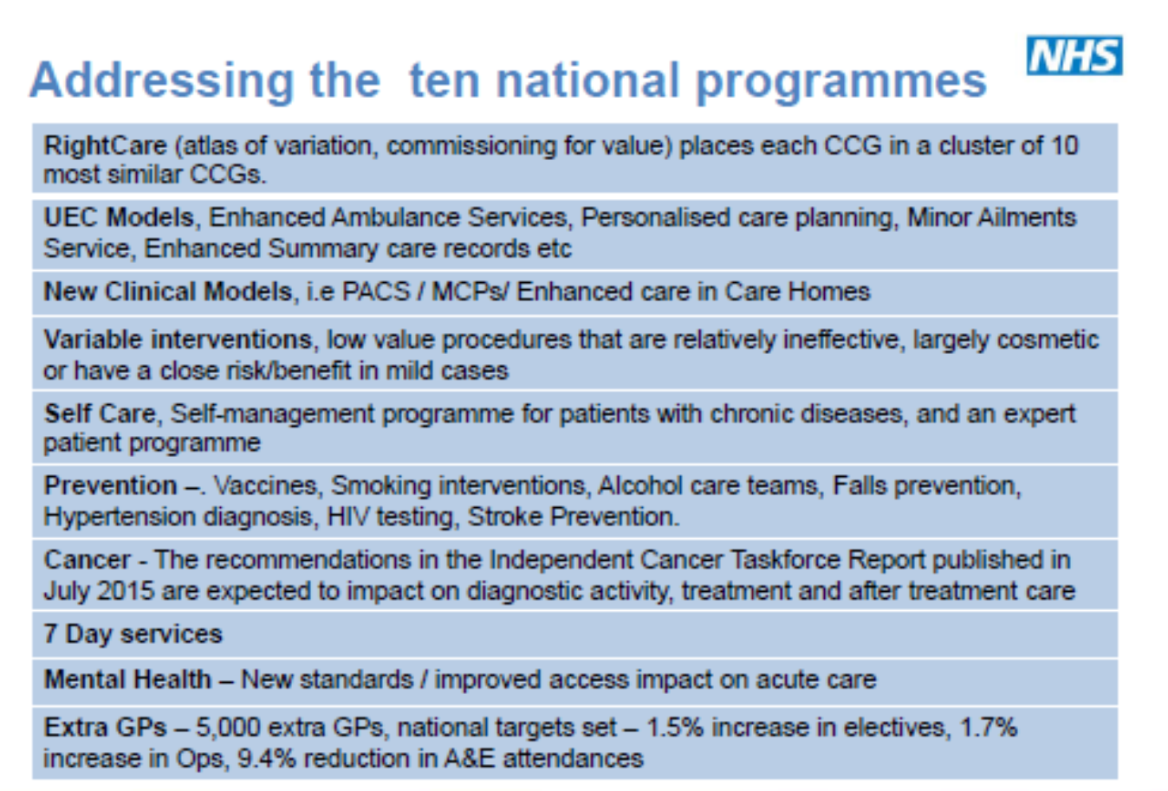
What do the plans need to think about?
How are you going to prevent ill health and moderate demand for healthcare?
How are you engaging patients, communities and NHS staff
How will you support, invest in and improve general practice
How will you implement new care models that address local challenges?
How will you achieve and maintain performance against core standards?
How will you achieve our 2020 ambitions on key clinical priorities
How will you improve quality and safety?
How will you deploy technology to accelerate change?
How will you develop the workforce you need to deliver?
How will you achieve and maintain financial balance?

Slide 32
Learning to Date
Population group served, and boundary of the system
  Size of population
  Specific population segments or whole population
  Population needs (and link with population covered)
Services
  Services included
  Services co-located (that may be additional to those that are included)
Dedicated team
  Roles and professional skills
Enablers
  Workforce
  Informatics
  Financing /contracting model
  Engagement and involvement
Impact to date
  Measures used to track progress
  Scaling up/building on models
Define clearly
Be explicit on outcomes
Use interim markers of success
Consider the “how” and the “what”

Slide 33
Conclusions
There is a huge challenge to meet the triple aim of:
Improving care quality, reducing variation and reducing costs
New Care Models are seen as a key element in achieving the aim
More emphasis is placed on primary care and on population health
Health integrating with social care
The organisational structure is less important than the clinical model
But we do not yet know whether these new Models will provide the outcomes hoped for

